Slide 1
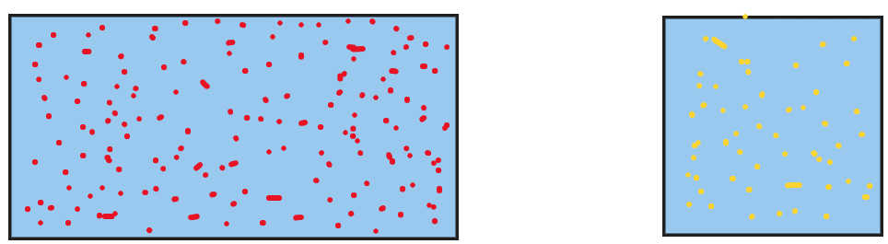

Sampling and Population
Population (N) = Complete data Sample (n) = Subset of data
Estimation: From sample mean -> Population mean, i.e. $\overline{x}→u$
Point estimate: Exact estimate, Interval estimate: A range of estimates (Called Confidence interval)

Slide 2
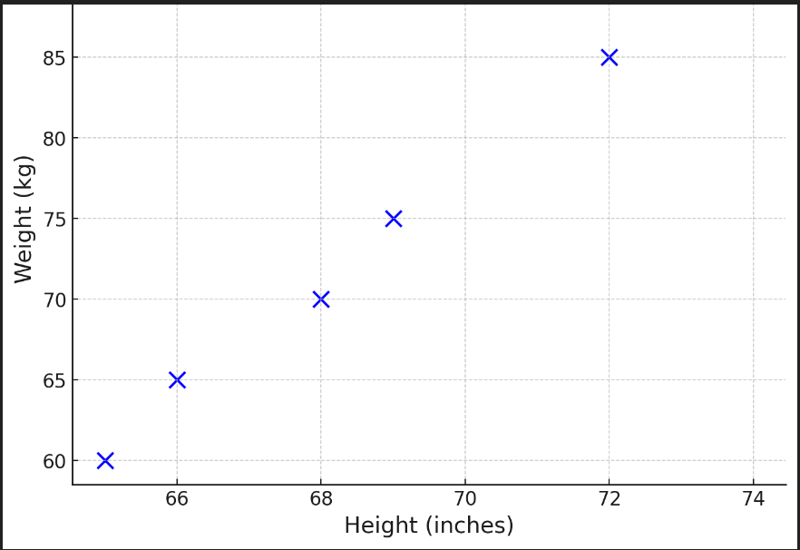
Cross-validation
Problem: Not sure which data to use for Training and which for Testing
Solution: Cross-validation
How? Use all the points for both Training and Testing iteratively (i.e. in steps)
Suppose we have weight and height data for six people
Question: How to decide what data to use for
Training and what data to use for Testing?
Bad idea: Use all the data for both
Why? May cause overfitting (See next slide)

Slide 3
Overfitting and Holdout Evaluation
A student who memorizes the answers to a specific set of questions for an exam but fails to answer questions on a different test
Memorizing versus Learning
Overfitting: A machine learning model performs exceptionally well on the training data but fails on new data
Overfit models memorize the training data rather than learning the underlying patterns
Hence, we must not use the entire data for training, but split data into something like 80% training and 20% testing
Holdout evaluation : Use the testing set to see how well the model performs

Slide 4
K-Fold Cross-Validation
K-fold cross-validation: Divide data into k groups (folds) and perform training and testing k times, once with each fold as the test set
Solution to overfitting
Select the one which gives the best results
Iteration | Training sets | Test set
1 | 1, 2 | 3
2 | 2, 3 | 1
3 | 3, 1 | 2

Slide 5
Sampling Techniques
Probability sampling: Random selection
Every member of the population has a chance of being selected
Most appropriate
Mainly used in quantitative research
Non-probability sampling: Non-random selection
Not every individual has a chance of being included
Easier and cheaper to access, has a higher risk of sampling bias
Used in qualitative research

Slide 6
Probability Sampling
Type | Brief description | Method | Example
Simple | Every member of the population has an equal chance | Random number generator | Assign # 1 to 1000 to employees and select n random samples
Systematic | Similar but easier | Choose at regular intervals | Pick employee # 7, 17, 27, 37, 47, …
Stratified | More representative, if we have sub-categories within data | Divide population into strata (sub-groups) and then pick proportionate samples from each | If we have 700 women employees and 300 men employees, pick 70 women and 30 men in the sample
Cluster | Similar, but use entire sub-groups, rather than samples within sub-groups | Divide population into clusters and pick entire clusters as samples | If the offices are in Pune, Mumbai, Delhi, Bangalore, Hyderabad, and Chennai select Pune and Chennai as samples

Slide 7
Non-Probability Sampling
Type | Brief description | Method | Example
Convenience | Just pick sample data as per one’s convenience | No systematic method | To research opinions about student support services in our university, we ask our fellow students to complete a survey on the topic
Voluntary-response | People voluntarily come forward | Start with the people who are interested – May be biased | Ask employees about problems faced through a third-party survey – unhappy employees will come forward on their own
Purposive | Done for a specific purpose, also called judgment sampling | Reach the right people and then do a detailed study | We want to know the opinions of foreign students at C-DAC, so we specifically talk to them about a variety of topics
Snowball | Recruit more participants via existing participants | Create a snowball of participants | Homeless people survey – Initially difficult to find such people to speak – But they may help us speak with others soon

Slide 8
Sample Space and Events, Probability

Slide 9
Sample Space and Events
Sample space: All the possible outcomes of an experiment
Event: A subset of the sample space
Sample space (S)
Event (E)

Slide 10
Events and Sample Space: Examples
Consider students in our class
Presence event
present
absent
Activeness event
active
inactive
Sample space
{(present, active), (present, inactive), (absent, active), (absent, inactive)}

Slide 11
Probability Definition
Impossible
Equal chance
Certain
0%
50%
100%
0
0.5
1
Probability: How likely it is that something will occur?
Written as a number or fraction (e.g. 0.5 or 50%)
Example:
What is the probability that it will rain today?
Sample space (S) = {R, NR}
P(R) = 1 / 2 = 0.5 or 50%
P(NR) = 1 / 2 = 0.5 or 50%
But what about rainy season?
It should be: P(R) = 100% and P(NR) = 0%
Theoretical probability: What will happen in theory?
Empirical/Practical probability: What actually happened?
Theoretical probability
Empirical probability

Slide 12
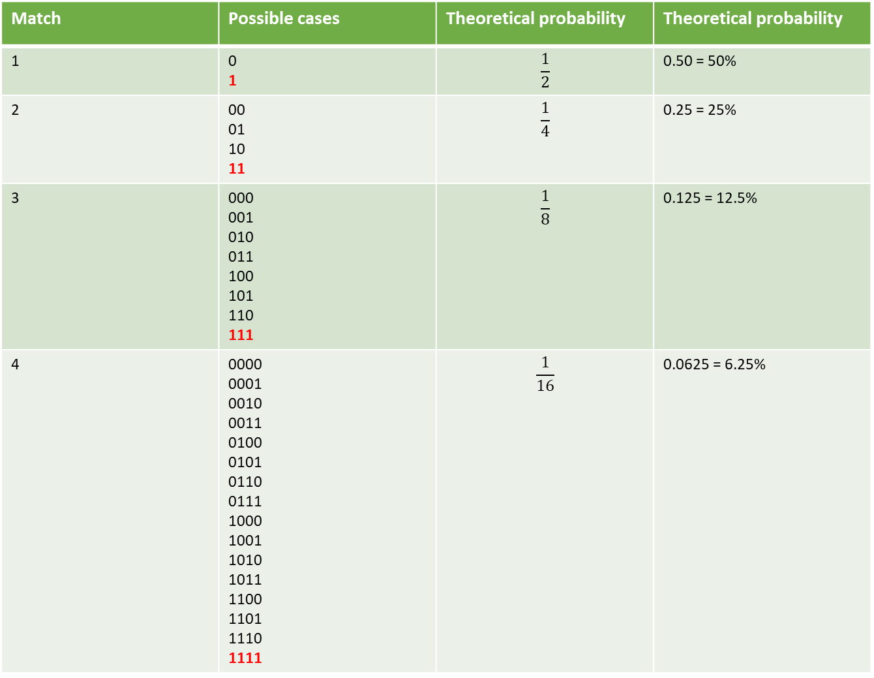
A team winning consecutive matches (Symbols: Win = 1, Loss = 0)
Match | Possible cases | Theoretical probability | Theoretical probability
1 | 0 1 | $$\frac{1}{2}$$ | 0.50 = 50%
2 | 00 01 10 11 | $$\frac{1}{4}$$ | 0.25 = 25%
3 | 000 001 010 011 100 101 110 111 | $$\frac{1}{8}$$ | 0.125 = 12.5%
4 | 0000 0001 0010 0011 0100 0101 0110 0111 1000 1001 1010 1011 1100 1101 1110 1111 | $$\frac{1}{16}$$ | 0.0625 = 6.25%
Imagine the team actually winning four consecutive matches
Theoretical probability would diminish to 6.25%
But the team has actually won! So, the empirical probability will be 100%

Slide 13
Marginal, Joint, Conditional Probability

Slide 14
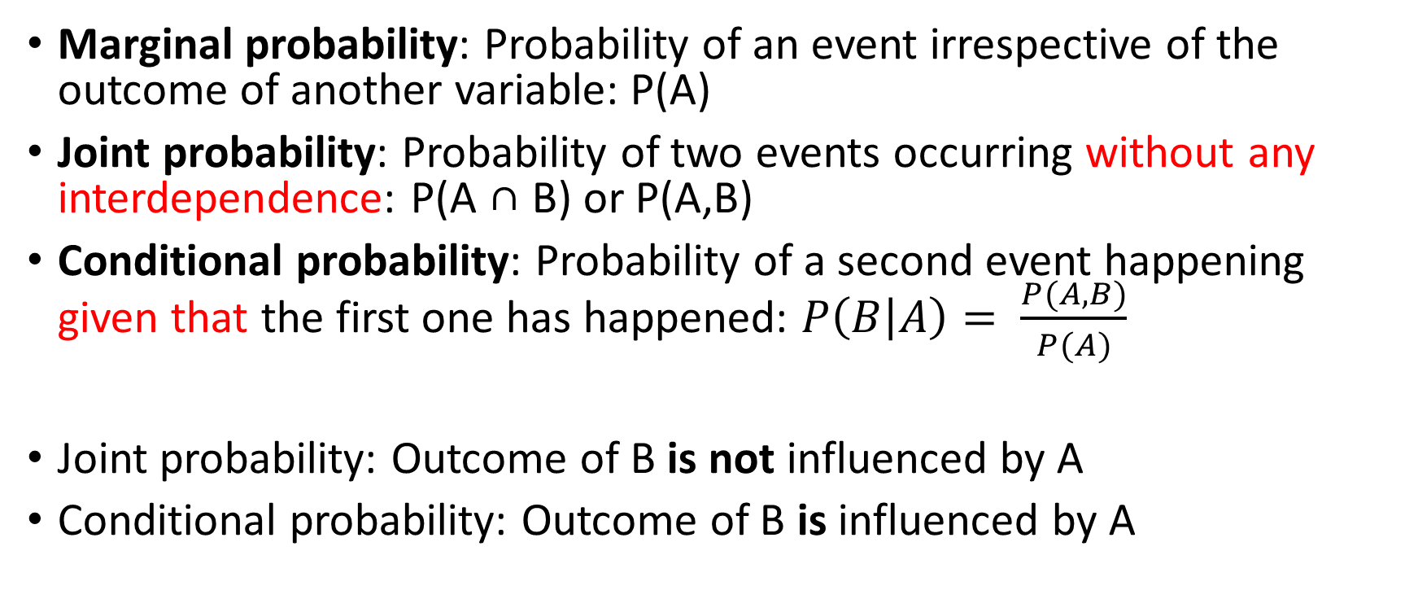
Basic Terms
Marginal probability: Probability of an event irrespective of the outcome of another variable: P(A)
Joint probability: Probability of two events occurring without any interdependence: P(A ∩ B) or P(A,B)
Conditional probability: Probability of a second event happening given that the first one has happened: $P\left(B | A\right)= \frac{P(A,B)}{P(A)}$
Joint probability: Outcome of B is not influenced by A
Conditional probability: Outcome of B is influenced by A

Slide 15
Marginal Probability
Example: In Pune, 70% people like apple and 30% people like orange
P(Apple) = 70%
P(Orange) = 30%
Both are examples of marginal probability

Slide 16
Independent Events
An independent series of events occur when the outcome of one event has no effect on the outcome of another
An example is flipping a fair coin twice
The chance of getting heads on the second toss is independent of the result of the first toss

Slide 17
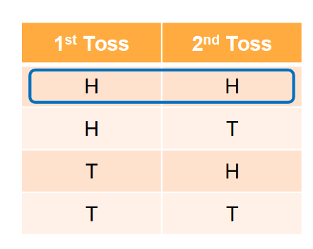

Independent Events – Example
The probability of seeing two heads with two flips of a fair coin is:
P(H1 H2) = P(H1) x P(H2)
= $\frac{1}{2}$ x $\frac{1}{2}$ = $\frac{1}{4}$

Slide 18
Dependent Events
A dependent event occurs when the outcome of a first event does affect the probability of a second event
Example: Draw colored marbles from a bag without replacement

Slide 19

Dependent Events
Imagine a jar contains 2 blue marbles and 3 red marbles
If you take two marbles out of the jar, what is the probability that they are both red?

Slide 20
Dependent Events
Here the color of the first marble affects the probability of drawing a 2nd red marble

Slide 21

Dependent Events
The probability of drawing a first red marble is easy:
P(R1) = $\frac{3}{5}$

Slide 22
Dependent Events
The probability of drawing a second red marble given that the first marble was red is written as:
P(R2|R1)

Slide 23
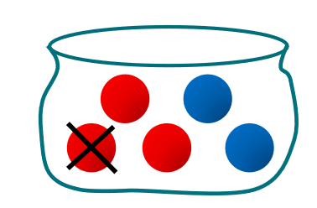

Dependent Events
After removing a red marble from the sample set this becomes :
P(R2|R1) = $\frac{2}{4}$

Slide 24

Dependent Events
So the probability of two red marbles is:
P(R1 Ո R2) = P(R1) x P(R2|R1) = $\frac{3}{5} x$ $\frac{2}{4}=\frac{6}{20}=0.3$

Slide 25
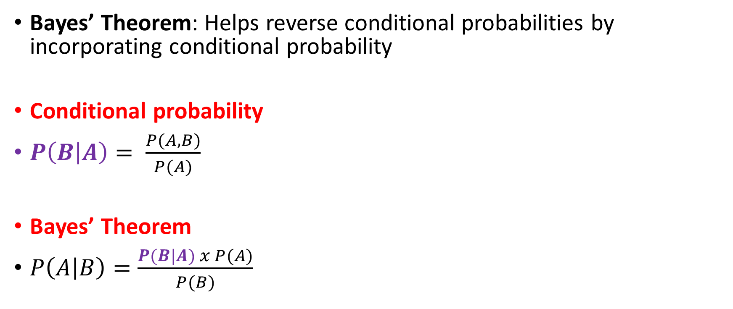
Conditional Probability to Bayes’ Theorem
Bayes’ Theorem: Helps reverse conditional probabilities by incorporating conditional probability
Conditional probability
$P\left(B | A\right)= \frac{P(A,B)}{P(A)}$
Bayes’ Theorem
$P\left(A | B\right)=\frac{P(B|A) x P(A)}{P(B)}$

Slide 26
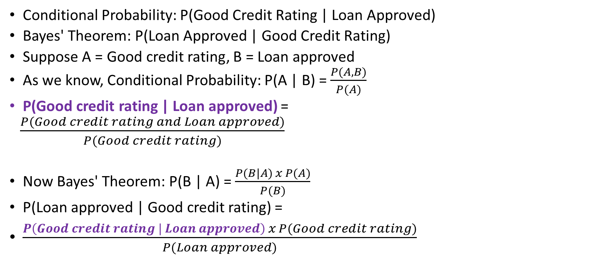
Conditional Probability to Bayes’ Theorem
Conditional Probability: P(Good Credit Rating | Loan Approved)
Bayes' Theorem: P(Loan Approved | Good Credit Rating)
Suppose A = Good credit rating, B = Loan approved
As we know, Conditional Probability: P(A | B) = $\frac{P(A,B)}{P(A)}$
P(Good credit rating | Loan approved) =
$\frac{P(Good credit rating and Loan approved)}{P(Good credit rating)}$
Now Bayes' Theorem: P(B | A) = $\frac{P(B|A) x P(A)}{P(B)}$
P(Loan approved | Good credit rating) =
$\frac{P\left(Good credit rating | Loan approved\right) x P(Good credit rating)}{P(Loan approved)}$

Slide 27
Bayes’ Theorem Example
10% of patients entering a clinic have liver disease
5% of patients entering a clinic are alcoholic
Out of the patients who have liver disease, 7% are alcoholics
A = Liver disease; So P(A) = 0.10
B = Alcoholic; So P(B) = 0.05
B|A = Patient is alcoholic, given that the patient has liver disease; So P(B|A) = 0.07
Find P(A|B), i.e. probability that the patient has liver disease, given that the patient is alcoholic

Slide 28
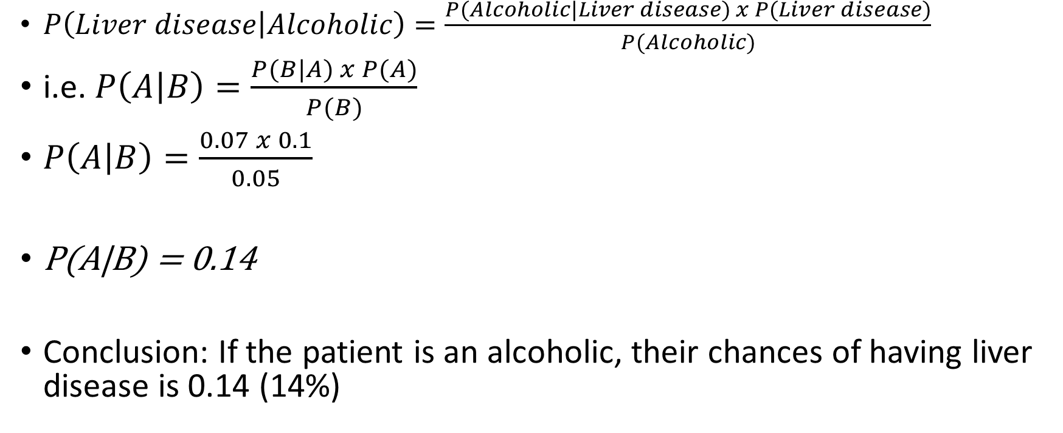
Bayes’ Theorem Example
$P\left(Liver disease | Alcoholic\right)=\frac{P(Alcoholic|Liver disease) x P(Liver disease)}{P(Alcoholic)}$
i.e. $P\left(A | B\right)=\frac{P(B|A) x P(A)}{P(B)}$
$P\left(A | B\right)=\frac{0.07 x 0.1}{0.05}$
P(A|B) = 0.14
Conclusion: If the patient is an alcoholic, their chances of having liver disease is 0.14 (14%)

Slide 29
Bayes’ Theorem Example
Rain prediction
Overall historical probability of rain: P(R) = 0.30
Sky condition
P(Overcast|Rain) = 0.8
P(Clear-sky|Rain) = 0.2
P(Overcast) = 0.6
Find P(Rain|Overcast), because today it is overcast
Suppose A = Rain, B = Overcast sky condition

Slide 30
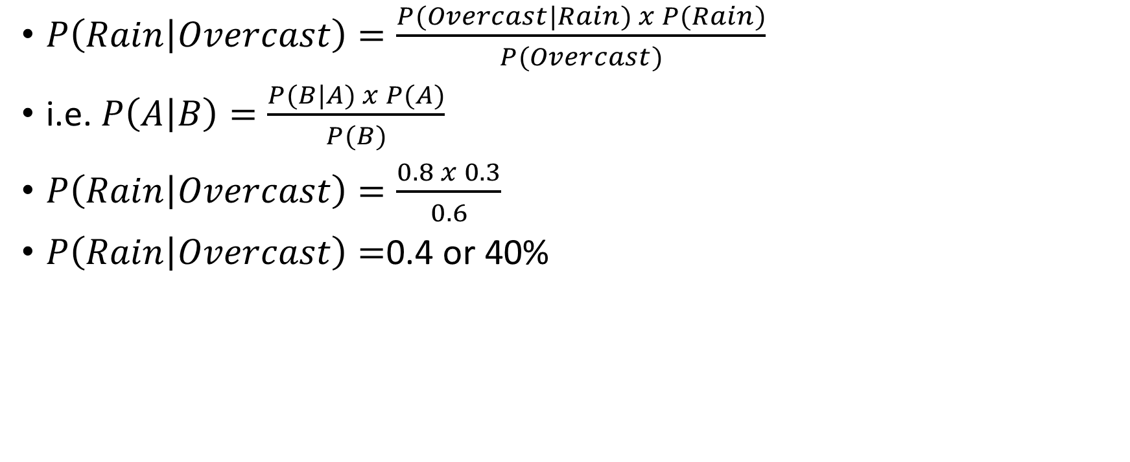
Bayes’ Theorem Example
$P\left(Rain | Overcast\right)=\frac{P(Overcast|Rain) x P(Rain)}{P(Overcast)}$
i.e. $P\left(A | B\right)=\frac{P(B|A) x P(A)}{P(B)}$
$P\left(Rain | Overcast\right)=\frac{0.8 x 0.3}{0.6}$
$P\left(Rain | Overcast\right)=$0.4 or 40%

Slide 31
Bayes’ Theorem
Dangerous fires are rare (1%)
Smoke is quite common due to barbecues (10%)
90% dangerous fires cause smoke
What is the probability that we have a dangerous fire when there is smoke?

Slide 32
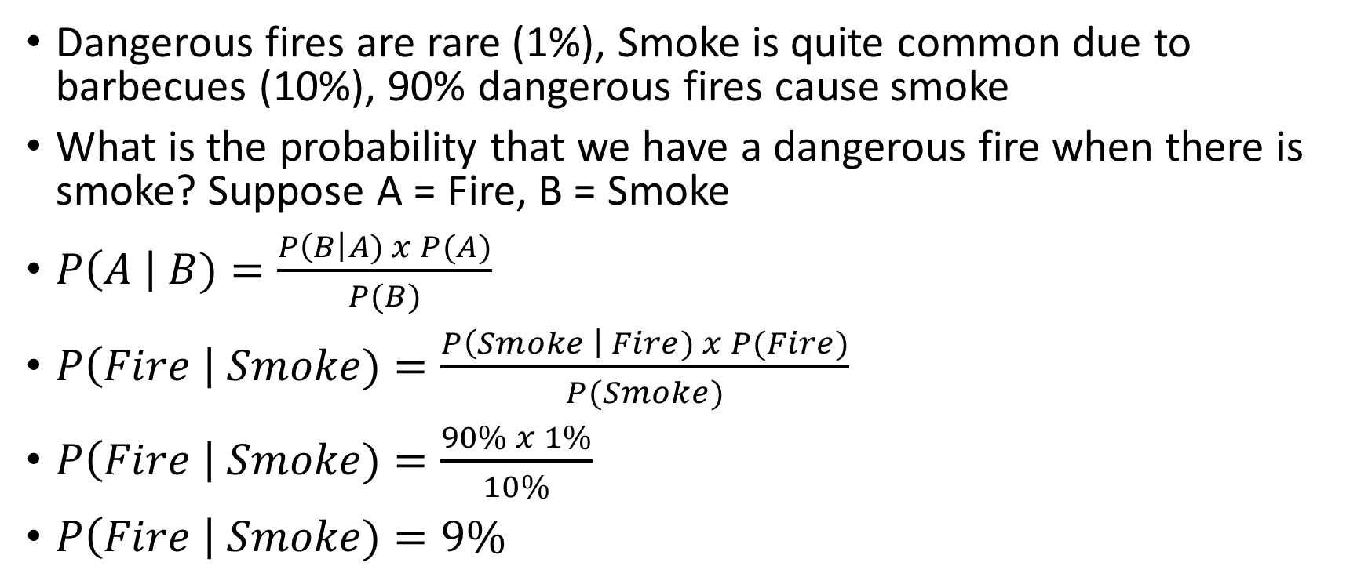
Bayes’ Theorem
Dangerous fires are rare (1%), Smoke is quite common due to barbecues (10%), 90% dangerous fires cause smoke
What is the probability that we have a dangerous fire when there is smoke? Suppose A = Fire, B = Smoke
$P\left(A \right| B)=\frac{P\left(B\right|A) x P(A)}{P(B)}$
$P\left(Fire \right| Smoke)=\frac{P\left(Smoke \right| Fire) x P(Fire)}{P(Smoke)}$
$P\left(Fire \right| Smoke)=\frac{90\% x 1\%}{10\%}$
$P\left(Fire \right| Smoke)=9\%$

